Slide 1

Exploratory data analysis for Labor market
Shoug Alkhathran
Instructor : Mejdal Alqahtani

Slide 2
Contents
01
Introduction
02
Data Structure
03
Data Cleaning
04
Data Analysis
05
Conclusion

Slide 3

Many people are asking about the most sought-after jobs in the labor market recenty, so I, as a data analyst, made use of the information provided on Bayt.com, the largest job site in the Middle East and North Africa, and it is the link between job seekers and employers who intend to hire. Every day, the region's top employers add thousands of vacancies to the platform

Slide 4
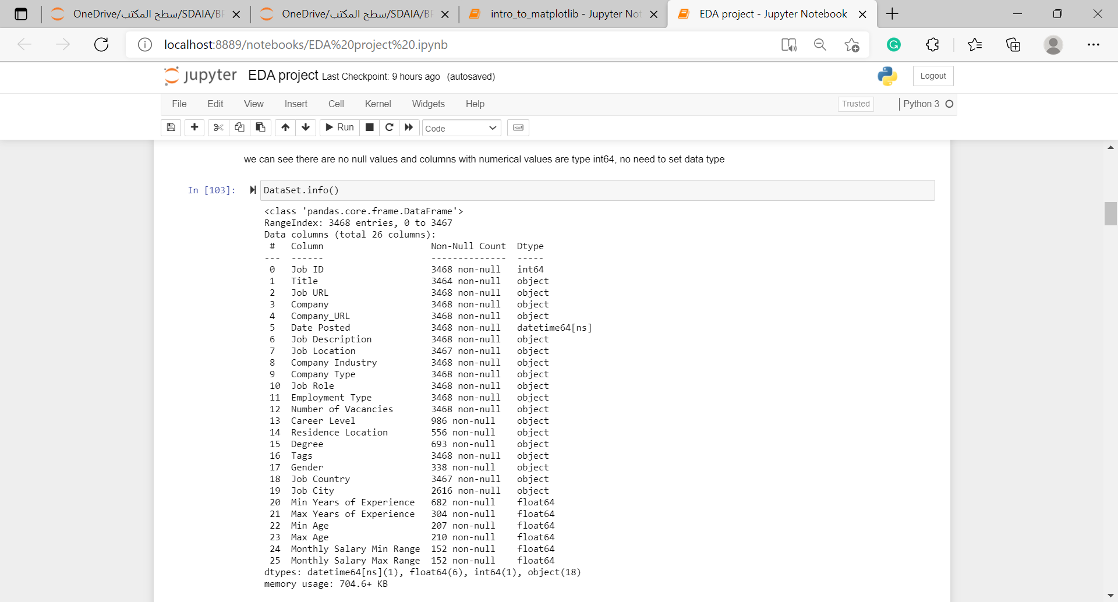
Data Structure
The dataset contains :
3,469 entries
26 features,
each row contains an ID that identifies each job posting.

Slide 5
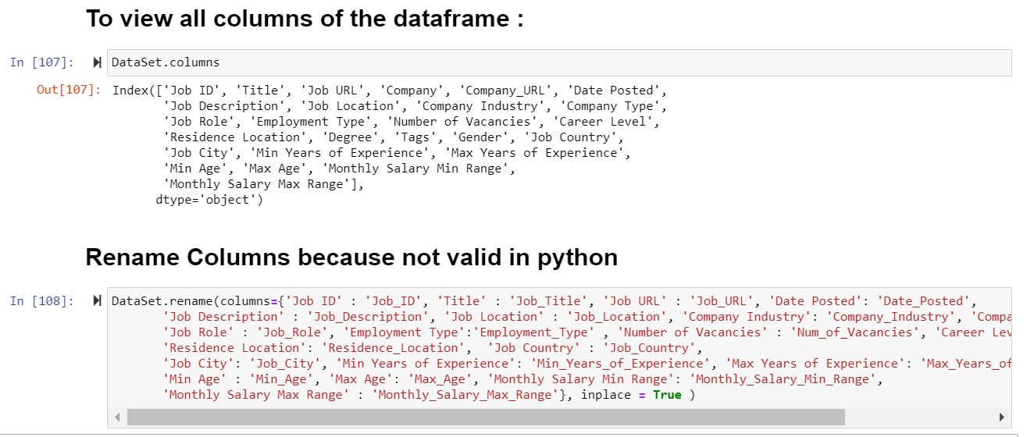

Data Cleaning
Rename Columns because not valid in python
01
02
03
04

Slide 6
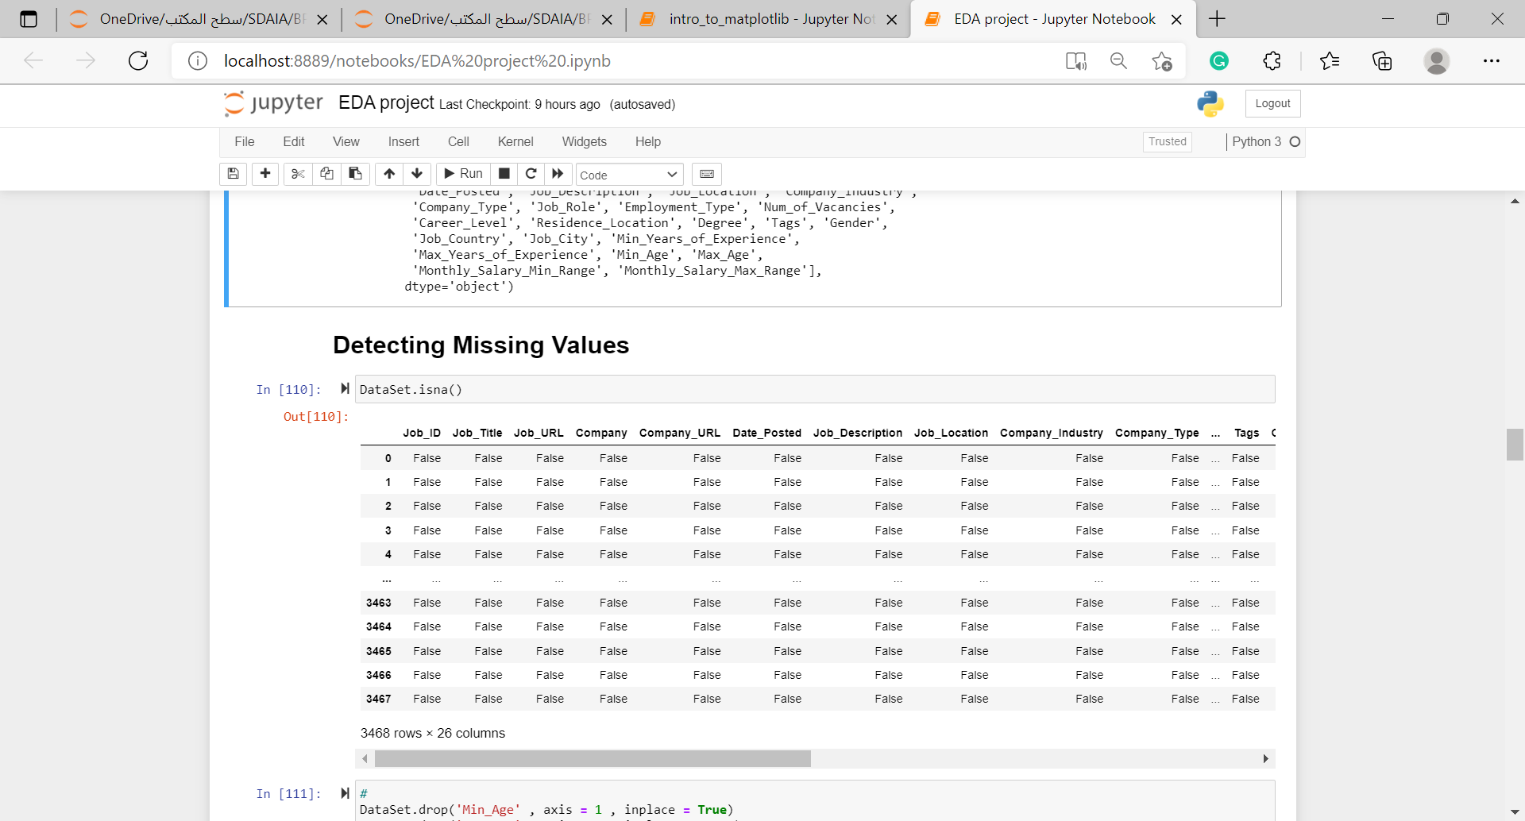
Data Cleaning
Detecting missing values with .isna()
01
02
03
04

Slide 7
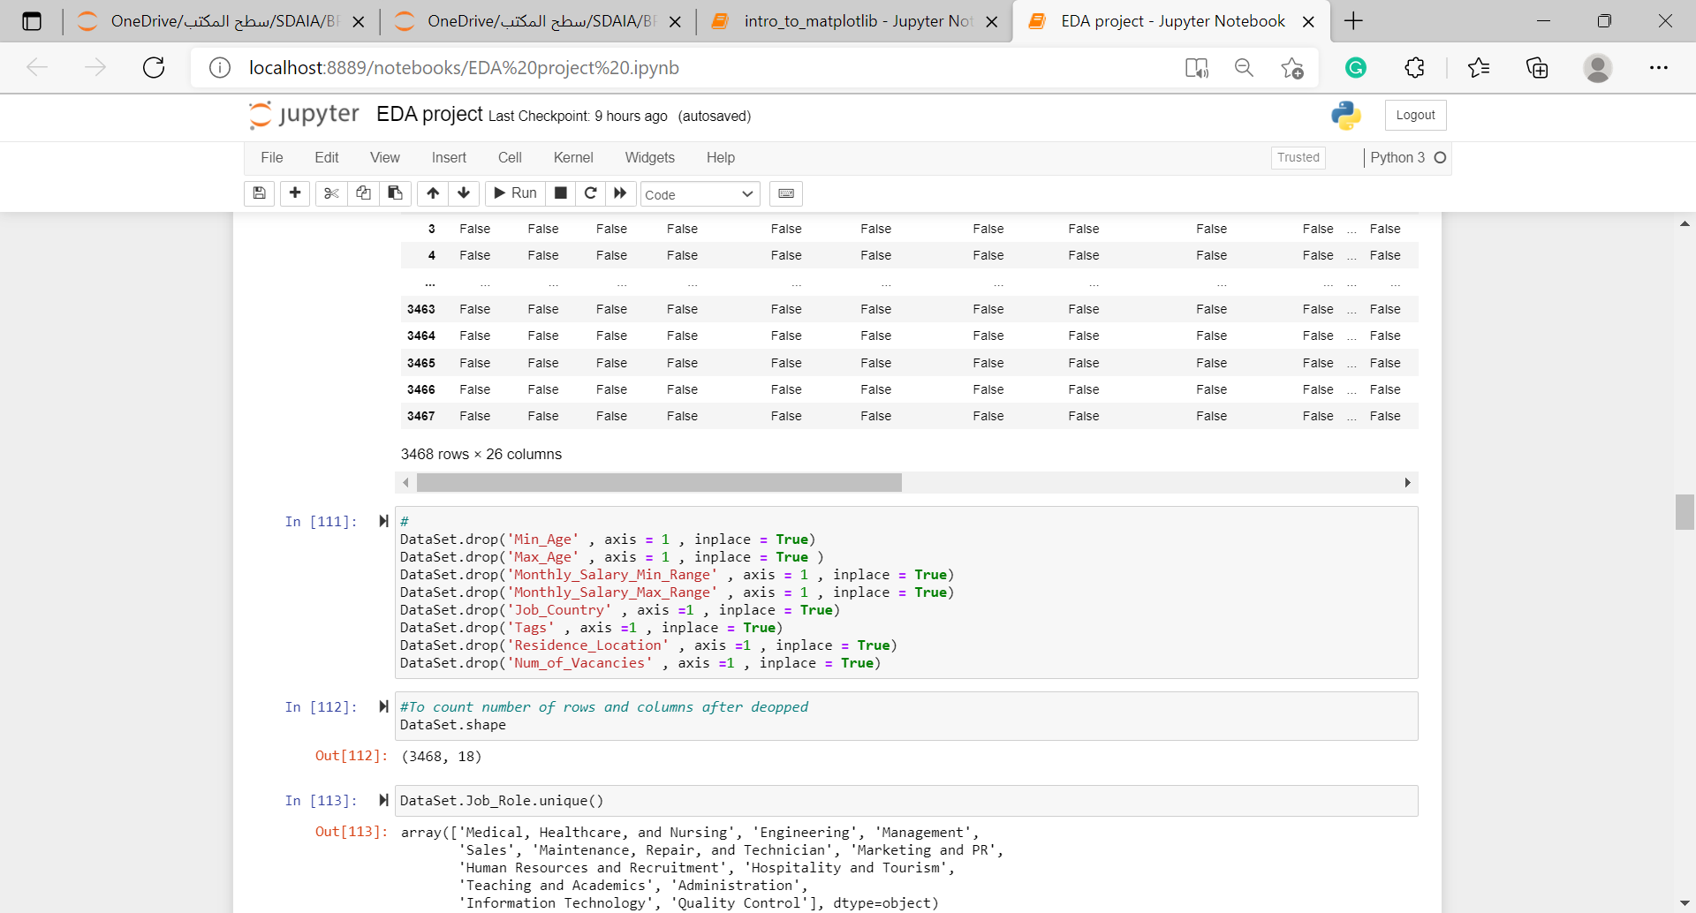
Data Cleaning
Drop unnecessary columns with
pandas .drop()
01
02
03
04

Slide 8
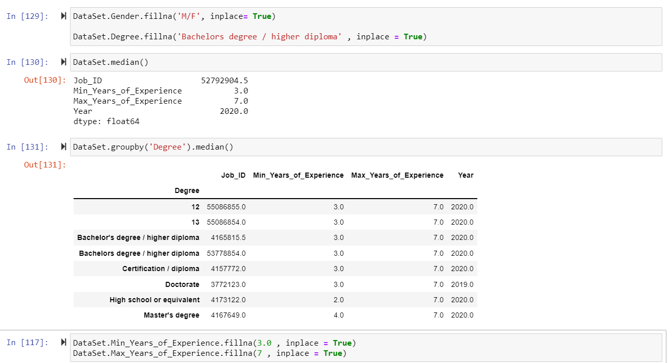
Data Cleaning
Handling with missing values
01
02
03
04

Slide 9
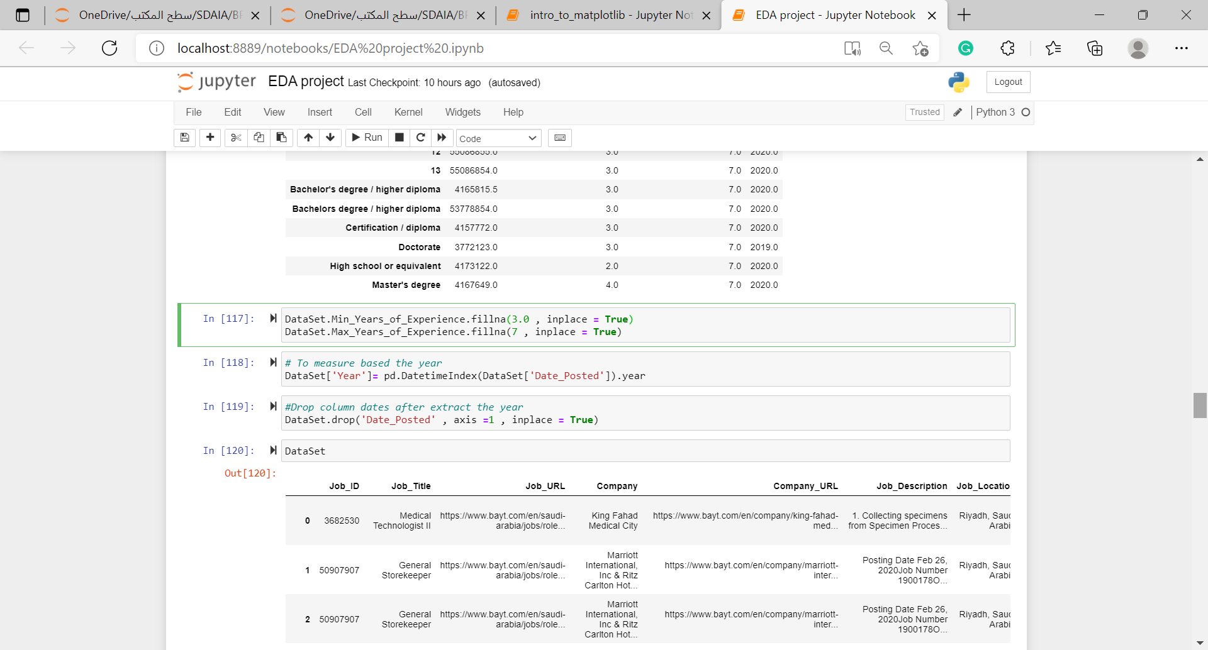
Data Analysis
Create new columns
01
02
03
04

Slide 10
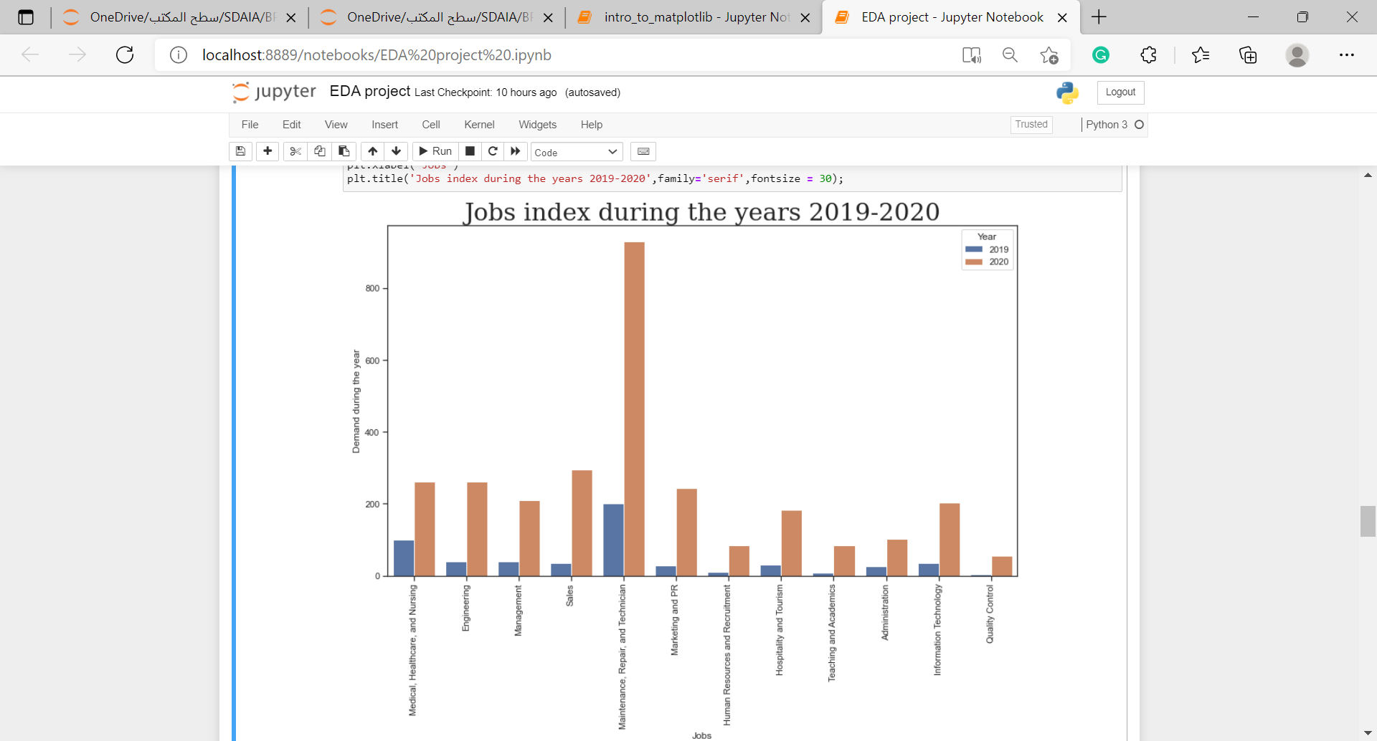
Data Analysis

Slide 11
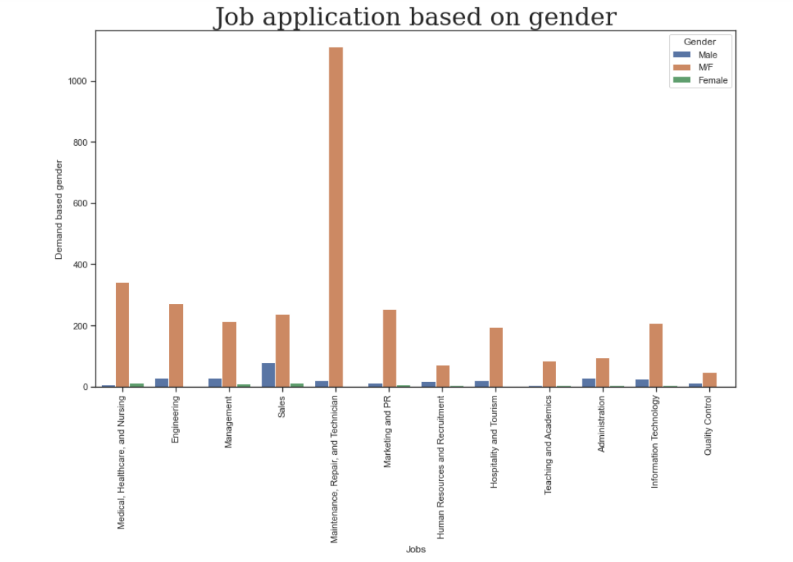

Data Analysis

Slide 12
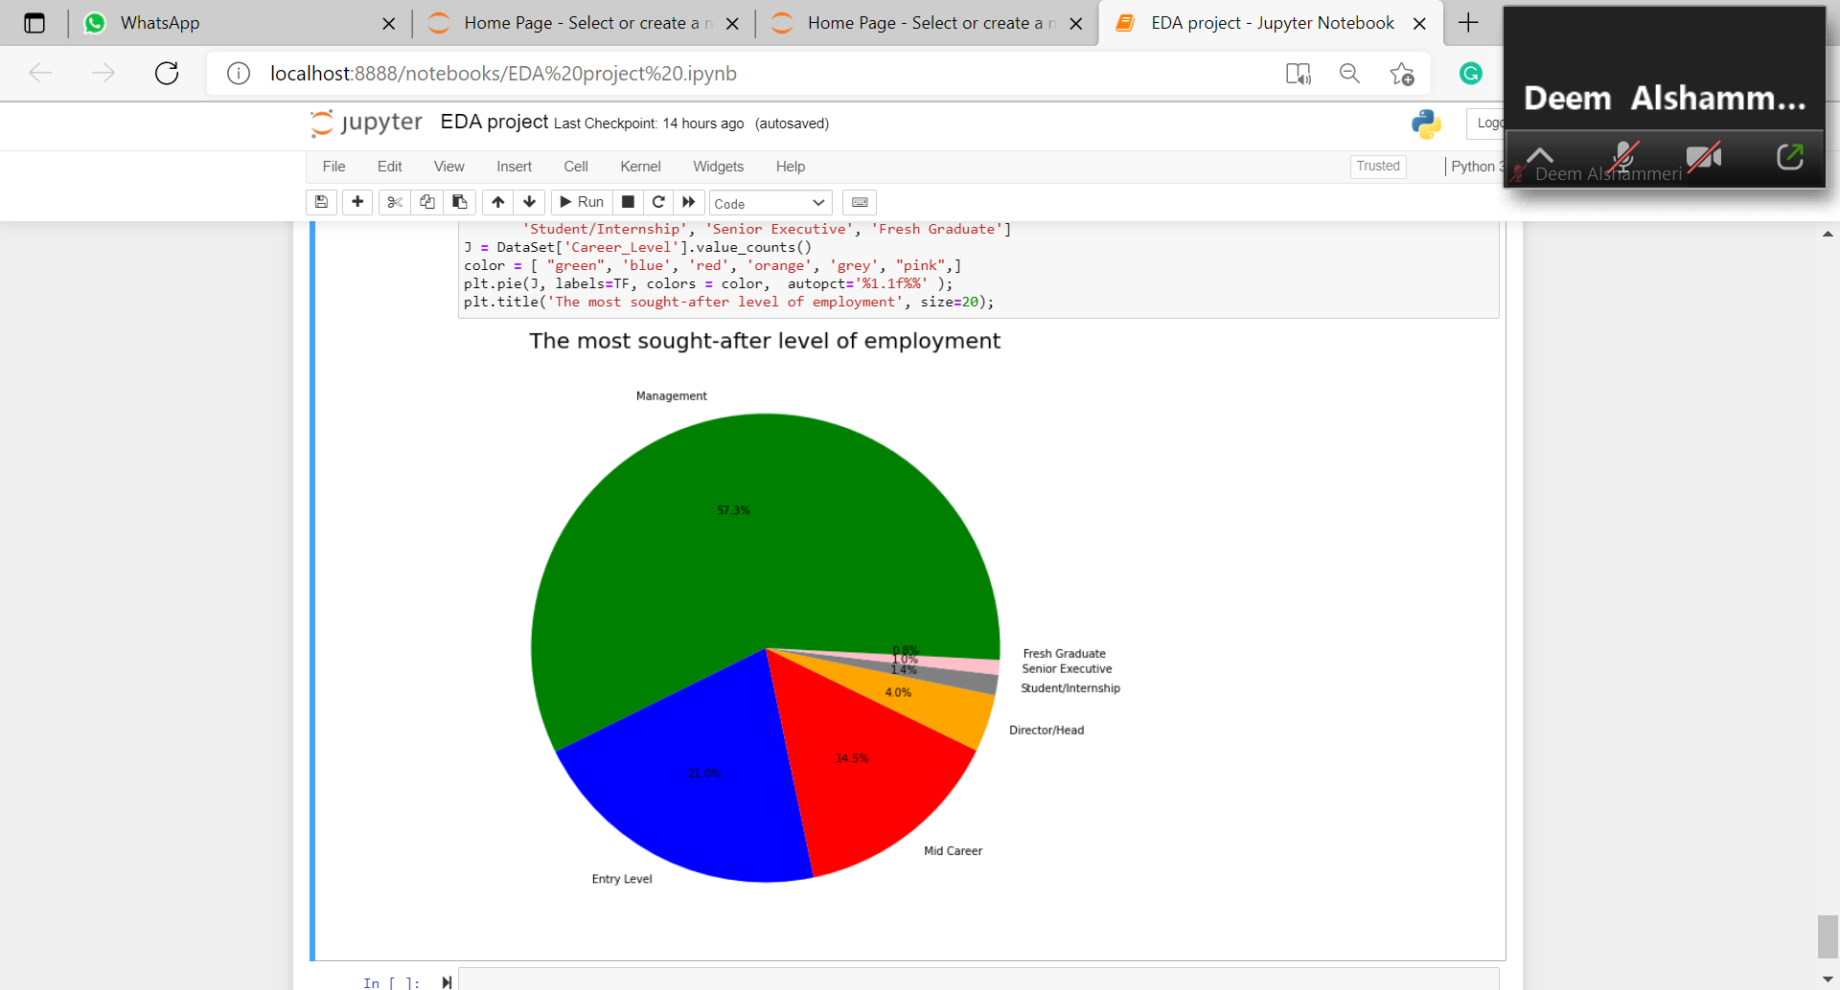
Data Analysis

Slide 13
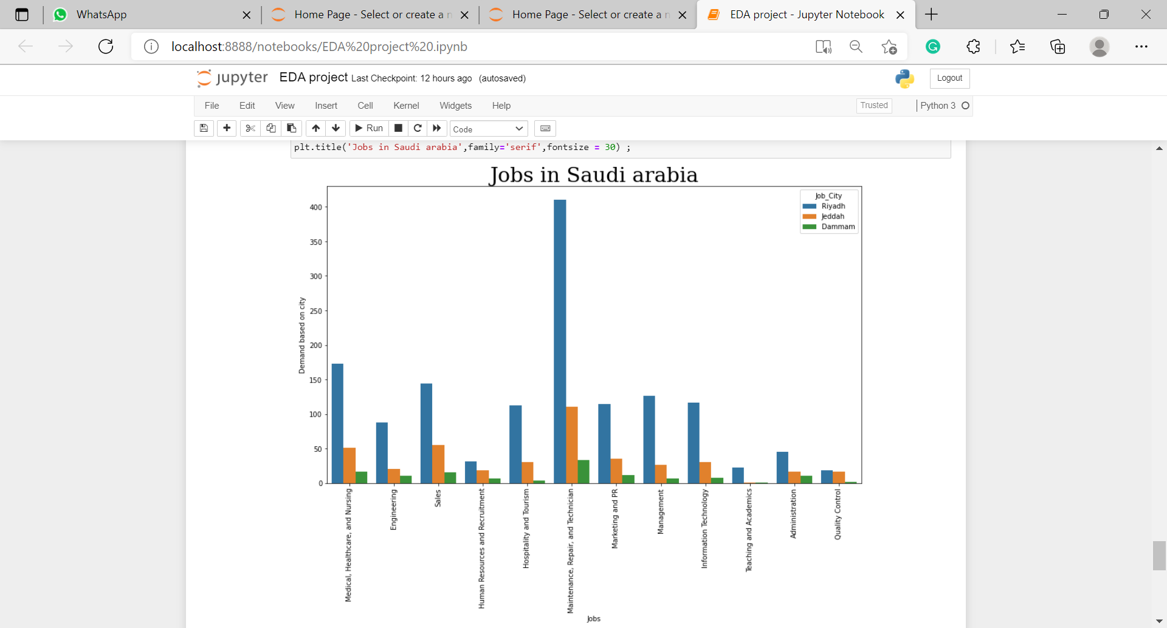
Data Analysis

Slide 14
Conclusion
Finally, I hope that this project will answer the questions of those who are about to choose their university majors, clarify the impressive achievement of the Kingdom of Saudi Arabia in advancing the labor market despite the conditions of the Covid-19 pandemic, and prove the strength of the digital transformation trend.
Future work
Deepening into the most in-demand technical and engineering sub-disciplines and knowing them more clearly.

Slide 15
Any Question
Thank you !!

